Slide 1
Naïve Bayes Classifier
Il-Chul Moon Dept. of Industrial and Systems Engineering KAIST
icmoon@kaist.ac.kr

Slide 2
Weekly Objectives
Learn the optimal classification concept
Know the optimal predictor
Know the concept of Bayes risk
Know the concept of decision boundary
Learn the naïve Bayes classifier
Understand the classifier
Understand the Bayesian version of linear classifier
Understand the conditional independence
Understand the naïve assumption
Apply the naïve Bayes classifier to a case study of a text mining
Learn the bag-of-words concepts
How to apply the classifier to document classifications

Slide 3
Optimal classification and decision boundary

Slide 4
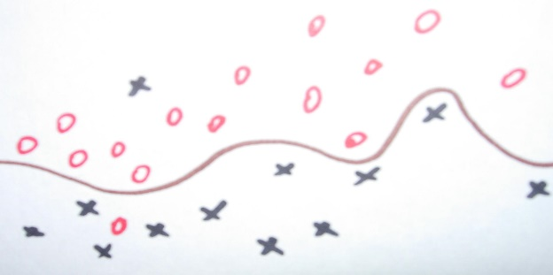
Supervised Learning
Supervised Learning
You know the true answers of some of instances
You know the true value, and you can provide examples of the true value.
Cases, such as
Spam filtering
Automatic grading
Automatic categorization
Classification or Regression of
Hit or Miss: Something has either disease or not.
Ranking: Someone received either A+, B, C, or F.
Types: An article is either positive or negative.
Value prediction: The price of this artifact is X.
Methodologies
Classification: estimating a discrete dependent value from observations
Regression: estimating a (continuous) dependent value from observations

Slide 5
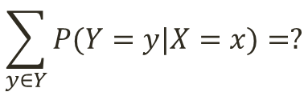
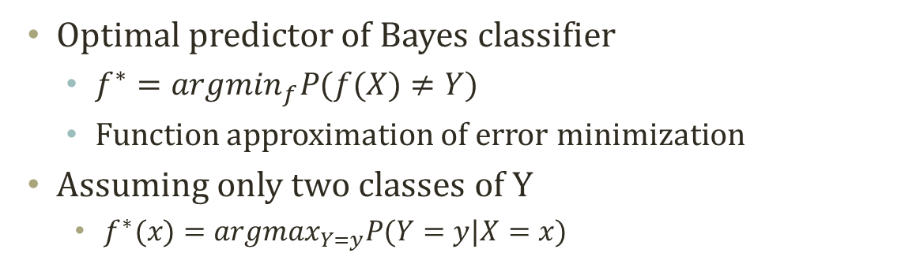
Optimal Classification
Optimal predictor of Bayes classifier
$f^{∗}={argmin}_{f}P(f(X)≠Y)$
Function approximation of error minimization
Assuming only two classes of Y
$f^{∗}(x)={argmax}_{Y=y}P(Y=y|X=x)$
$$\sum_{y∈Y}{P(Y=y|X=x)}=?$$
P(Y=y|X)
P(Y=y|X)
1
0
X

Slide 6
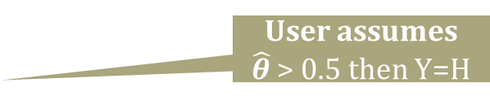
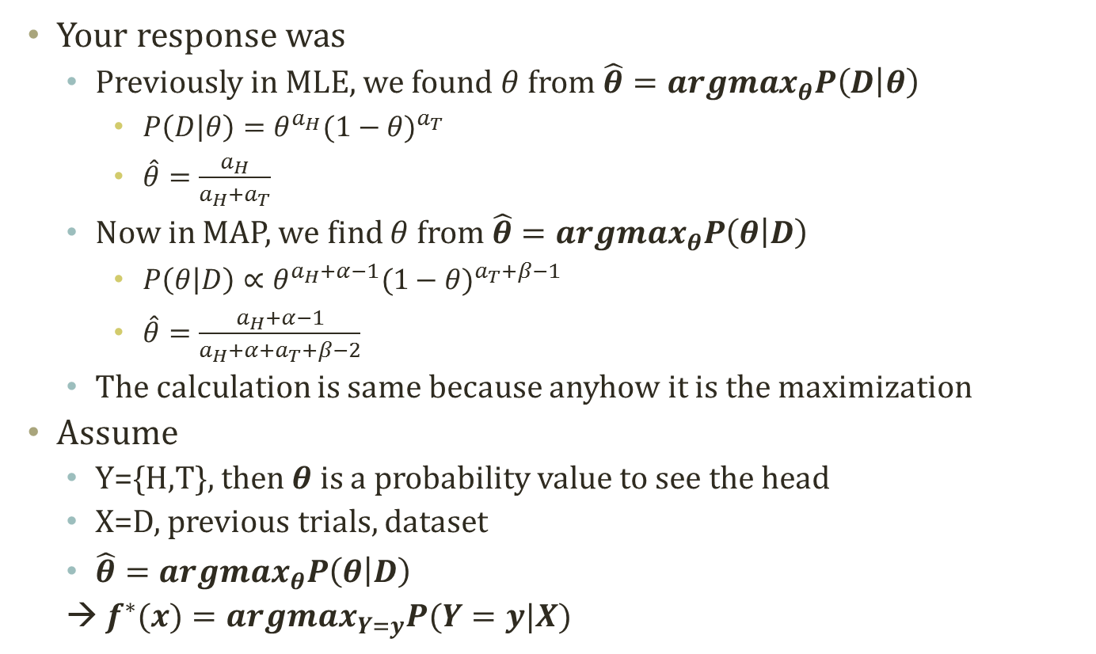
Detour: Thumbtack MLE and MAP
Your response was
Previously in MLE, we found $θ$ from $\hat{θ}={argmax}_{θ}P\left(D | θ\right)$
$P\left(D | θ\right)=θ^{a_{H}}{(1−θ)}^{a_{T}}$
$\hat{θ}=\frac{a_{H}}{a_{H}+a_{T}}$
Now in MAP, we find $θ$ from $\hat{θ}={argmax}_{θ}P\left(θ | D\right)$
$P\left(θ | D\right)∝θ^{a_{H}+α−1}{(1−θ)}^{a_{T}+β−1}$
$\hat{θ}=\frac{a_{H}+α−1}{a_{H}+α+a_{T}+β−2}$
The calculation is same because anyhow it is the maximization
Assume
Y={H,T}, then $θ$ is a probability value to see the head
X=D, previous trials, dataset
$\hat{θ}={argmax}_{θ}P\left(θ | D\right)$
→ $f^{∗}(x)={argmax}_{Y=y}P(Y=y|X)$
User assumes $\hat{θ}$ > 0.5 then Y=H
Classifier tells Y=H or not

Slide 7
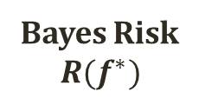
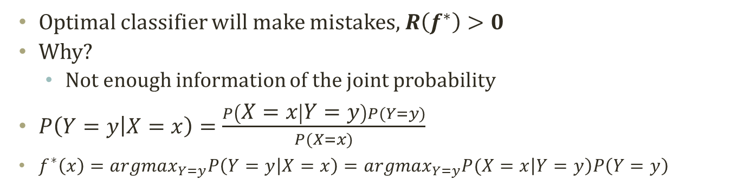
Optimal Classification and Bayes Risk
P(Y=y|X)
P(Y=y|X)
1
Bayes Risk
$$R(f^{∗})$$
0
X
Classify as y
Classify as y
Optimal classifier will make mistakes, $R\left(f^{∗}\right)>0$
Why?
Not enough information of the joint probability
$P\left(Y=y | X=x\right)=\frac{P\left(X=x | Y=y\right)P(Y=y)}{P(X=x)}$
$f^{∗}\left(x\right)={argmax}_{Y=y}P\left(Y=y | X=x\right)={argmax}_{Y=y}P(X=x\left|Y=y\right)P\left(Y=y\right)$
Class Conditional Density
Class Prior

Slide 8
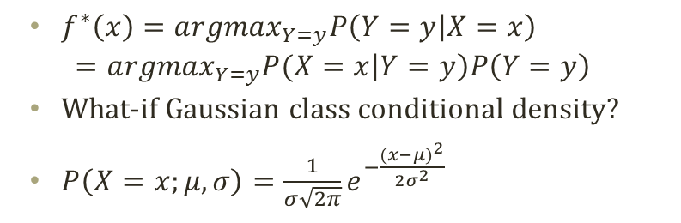
Decision Boundary
Decision Boundary
P(Y=y|X)
P(Y=y|X)
1
Bayes Risk
$$R(f^{∗})$$
0
X
Classify as y
Classify as y
Why are shapes different?
P(X=x|Y=y)P(Y=y)
$f^{∗}\left(x\right)={argmax}_{Y=y}P\left(Y=y | X=x\right)$
$$={argmax}_{Y=y}P(X=x\left|Y=y\right)P\left(Y=y\right)$$
What-if Gaussian class conditional density?
$P\left(X=x;μ,σ\right)=\frac{1}{σ\sqrt{2π}}e^{−\frac{{(x−μ)}^{2}}{2σ^{2}}}$
P(X=x|Y=y)P(Y=y)
X

Slide 9
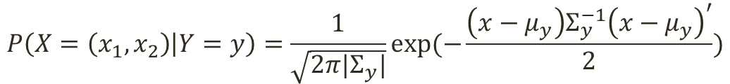
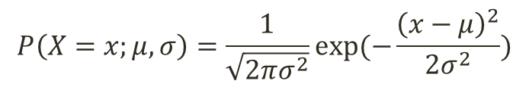
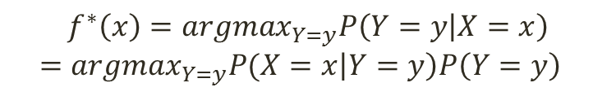
Decision Boundary in Two Dimension
Decision Boundary in Two Dimensions
$$f^{∗}\left(x\right)={argmax}_{Y=y}P\left(Y=y | X=x\right)$$
$$={argmax}_{Y=y}P(X=x\left|Y=y\right)P\left(Y=y\right)$$
P(X=x|Y=y)P(Y=y)
Two multivariate normal distribution for the class conditional densities
Decision boundary
A linear line
Linear decision boundary
Any problem in the real world applications?
Observing the combination of x₁ and x₂
P(X=x|Y=y)P(Y=y)
$$P\left(X=x;μ,σ\right)=\frac{1}{\sqrt{2πσ^{2}}}exp⁡(−\frac{{\left(x−μ\right)}^{2}}{2σ^{2}})$$
$$P\left(X=\left(x_{1},x_{2}\right) | Y=y\right)=\frac{1}{\sqrt{2π|Σ_{y}|}}exp⁡(−\frac{\left(x−μ_{y}\right)Σ_{y}^{−1}{\left(x−μ_{y}\right)}^{′}}{2})$$

Slide 10
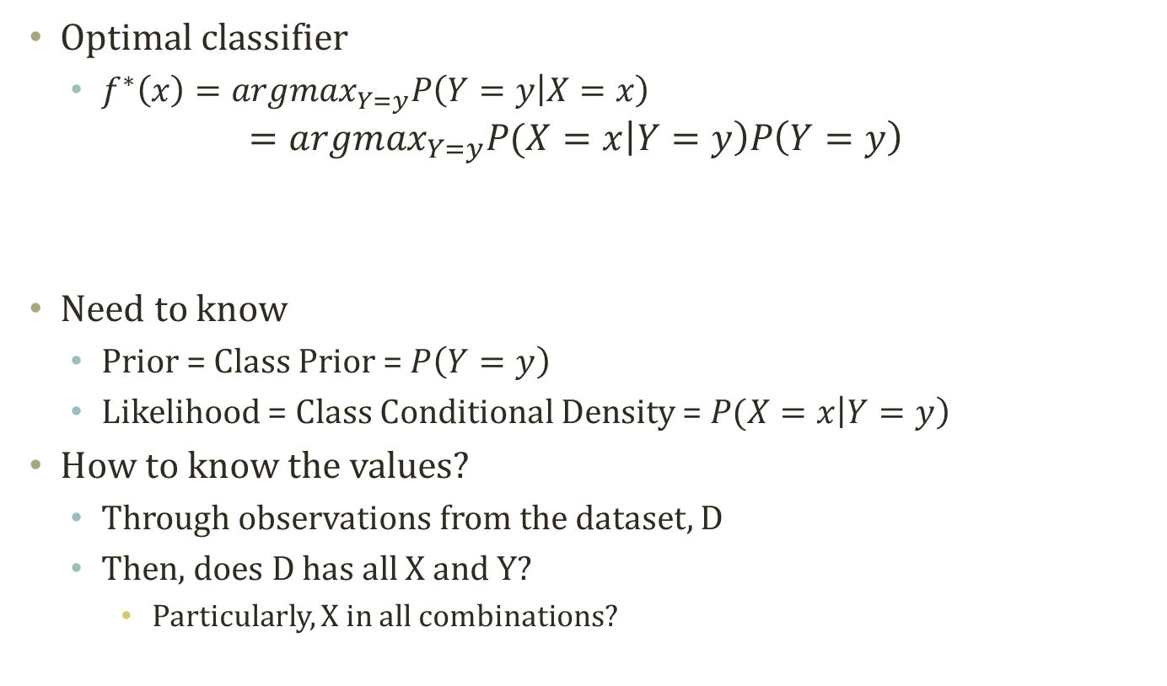
Learning the Optimal Classifier
Optimal classifier
$f^{∗}\left(x\right)={argmax}_{Y=y}P\left(Y=y | X=x\right)$
$$={argmax}_{Y=y}P(X=x\left|Y=y\right)P\left(Y=y\right)$$
Need to know
Prior = Class Prior = $P\left(Y=y\right)$
Likelihood = Class Conditional Density = $P(X=x\left|Y=y\right)$
How to know the values?
Through observations from the dataset, D
Then, does D has all X and Y?
Particularly, X in all combinations?
Class Conditional Density
Class Prior

Slide 11
Naïve bayes classifier

Slide 12
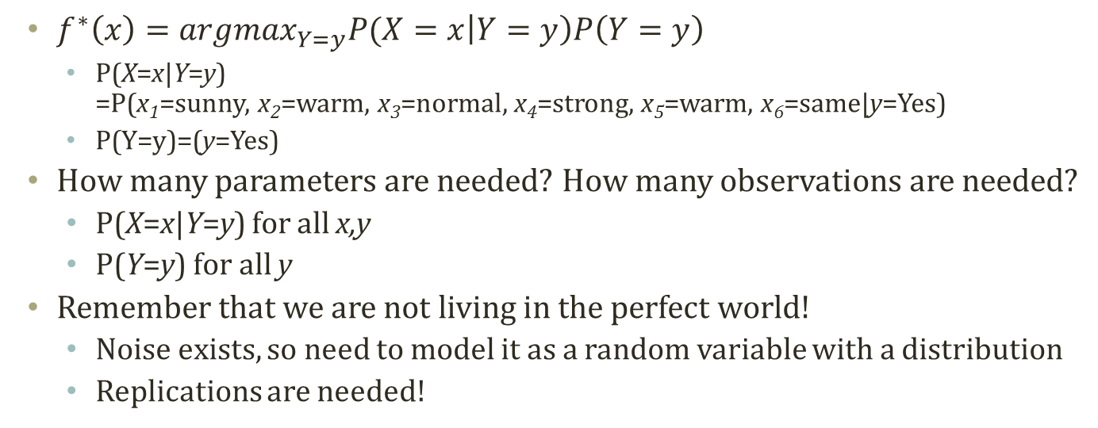
Dataset for Optimal Classifier Learning
Sky | Temp | Humid | Wind | Water | Forecst | EnjoySpt
Sunny | Warm | Normal | Strong | Warm | Same | Yes
Sunny | Warm | High | Strong | Warm | Same | Yes
Rainy | Cold | High | Strong | Warm | Change | No
Sunny | Warm | High | Strong | Cool | Change | Yes
$f^{∗}\left(x\right)={argmax}_{Y=y}P(X=x\left|Y=y\right)P\left(Y=y\right)$
P(X=x|Y=y) =P(x₁=sunny, x₂=warm, x₃=normal, x₄=strong, x₅=warm, x₆=same|y=Yes)
P(Y=y)=(y=Yes)
How many parameters are needed? How many observations are needed?
P(X=x|Y=y) for all x,y
P(Y=y) for all y
Remember that we are not living in the perfect world!
Noise exists, so need to model it as a random variable with a distribution
Replications are needed!
(2^{d}-1)k
Often, what happens is
N >> (2^{d}-1)k >> |D|
k-1

Slide 13
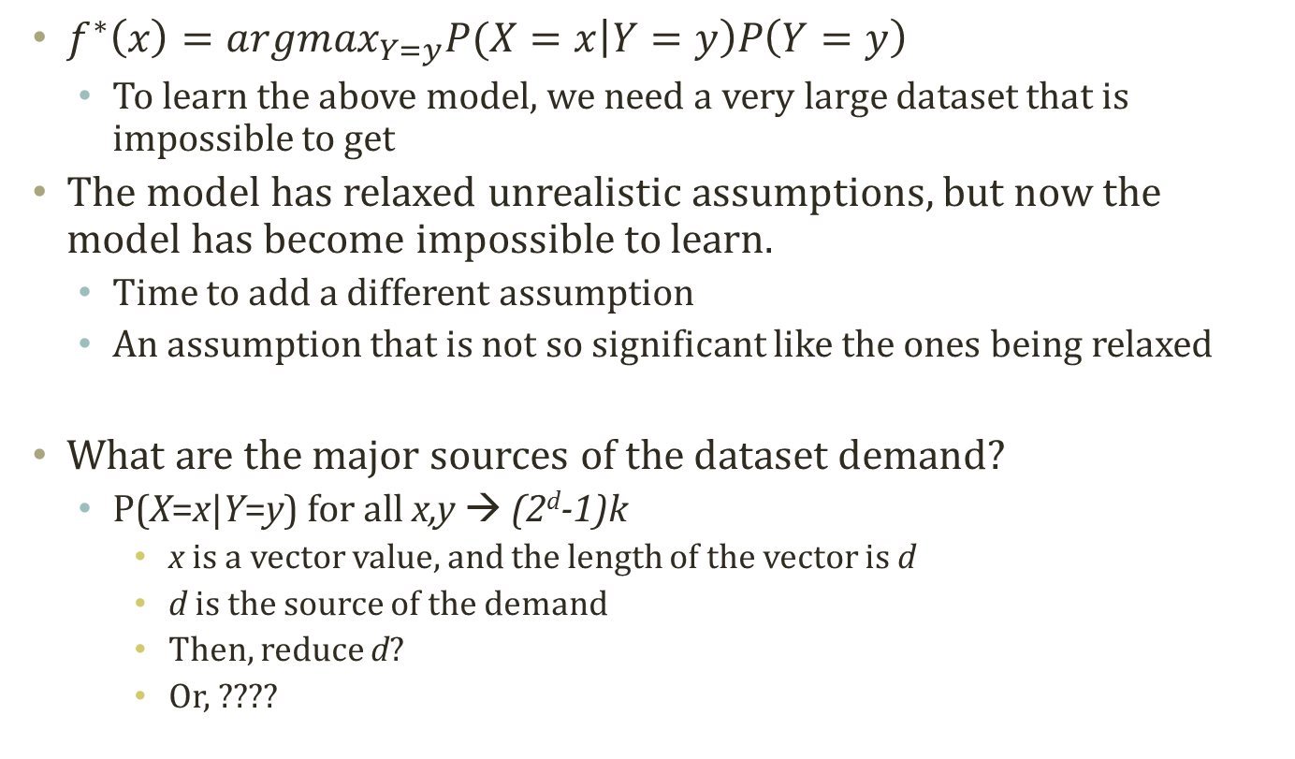
Why need an additional assumption?
$f^{∗}\left(x\right)={argmax}_{Y=y}P(X=x\left|Y=y\right)P\left(Y=y\right)$
To learn the above model, we need a very large dataset that is impossible to get
The model has relaxed unrealistic assumptions, but now the model has become impossible to learn.
Time to add a different assumption
An assumption that is not so significant like the ones being relaxed
What are the major sources of the dataset demand?
P(X=x|Y=y) for all x,y → (2^{d}-1)k
x is a vector value, and the length of the vector is d
d is the source of the demand
Then, reduce d?
Or, ????

Slide 14
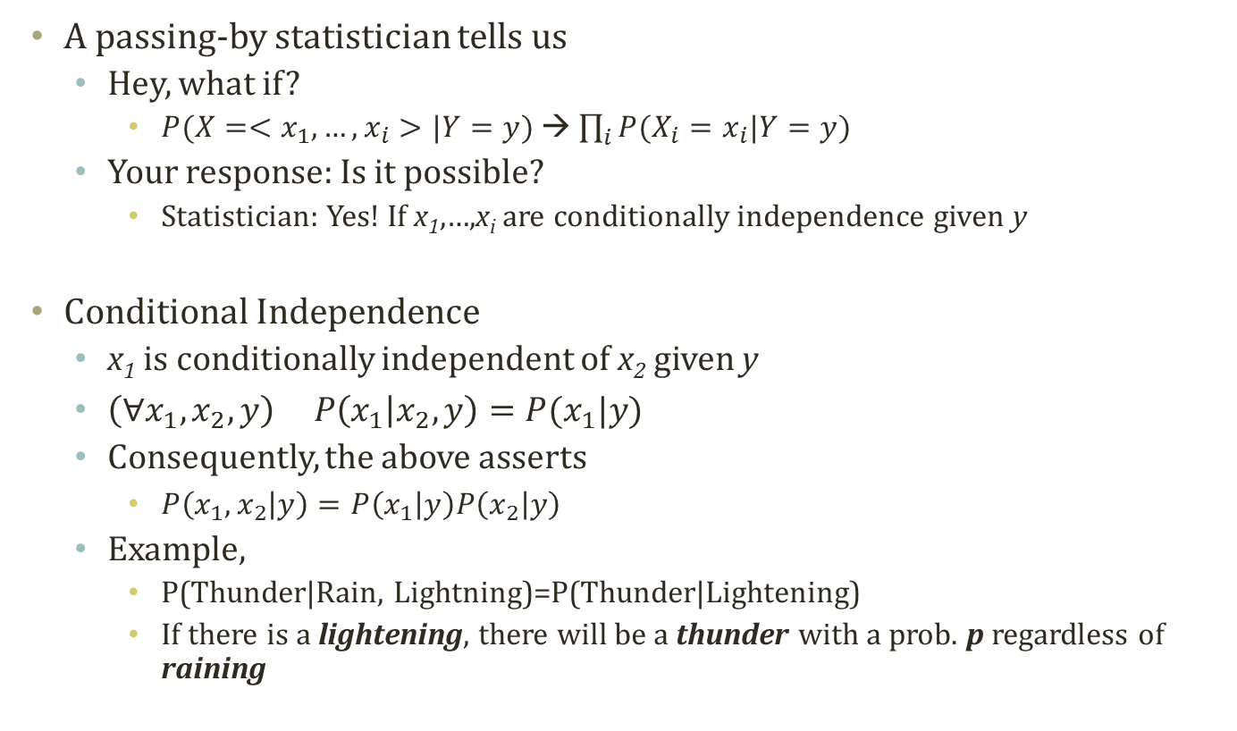
Conditional Independence
A passing-by statistician tells us
Hey, what if?
$P(X=<x_{1},…,x_{i}>|Y=y)$ → $\prod_{i}{P(X_{i}=x_{i}|Y=y)}$
Your response: Is it possible?
Statistician: Yes! If x₁,…,x_{i} are conditionally independence given y
Conditional Independence
x₁ is conditionally independent of x₂ given y
$\left(∀x_{1},x_{2},y\right) P\left(x_{1} | x_{2},y\right)=P(x_{1}|y)$
Consequently, the above asserts
$P\left(x_{1},x_{2} | y\right)=P\left(x_{1} | y\right)P\left(x_{2} | y\right)$
Example,
P(Thunder|Rain, Lightning)=P(Thunder|Lightening)
If there is a lightening, there will be a thunder with a prob. p regardless of raining

Slide 15

Conditional vs. Marginal Independence
Go!
Go?
Commander
Go?
OfficerA
OfficerB
Marginal independence
P(OfficerA=Go|OfficerB=Go) > P(OfficerA=Go)
This is not marginally independent!
X and Y are independent if and only if P(X)=P(X|Y)
Consequently, P(X,Y)=P(X)P(Y)
Conditional independence
P(OfficerA=Go|OfficerB=Go,Commander=Go) =P(OfficerA=Go|Commander=Go)
This is conditionally independent!

Slide 16
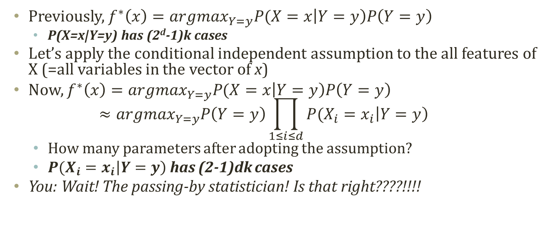
Dataset for Optimal Classifier Learning with Conditional Independent Assumption
Sky | Temp | Humid | Wind | Water | Forecst | EnjoySpt
Sunny | Warm | Normal | Strong | Warm | Same | Yes
Sunny | Warm | High | Strong | Warm | Same | Yes
Rainy | Cold | High | Strong | Warm | Change | No
Sunny | Warm | High | Strong | Cool | Change | Yes
Previously, $f^{∗}\left(x\right)={argmax}_{Y=y}P(X=x\left|Y=y\right)P\left(Y=y\right)$
P(X=x|Y=y) has (2^{d}-1)k cases
Let’s apply the conditional independent assumption to the all features of X (=all variables in the vector of x)
Now, $f^{∗}\left(x\right)={argmax}_{Y=y}P(X=x\left|Y=y\right)P\left(Y=y\right)$ $≈{argmax}_{Y=y}P\left(Y=y\right)\prod_{1≤i≤d}{P(X_{i}=x_{i}\left|Y=y\right)}$
How many parameters after adopting the assumption?
$P(X_{i}=x_{i}\left|Y=y\right)$ has (2-1)dk cases
You: Wait! The passing-by statistician! Is that right????!!!!

Slide 17
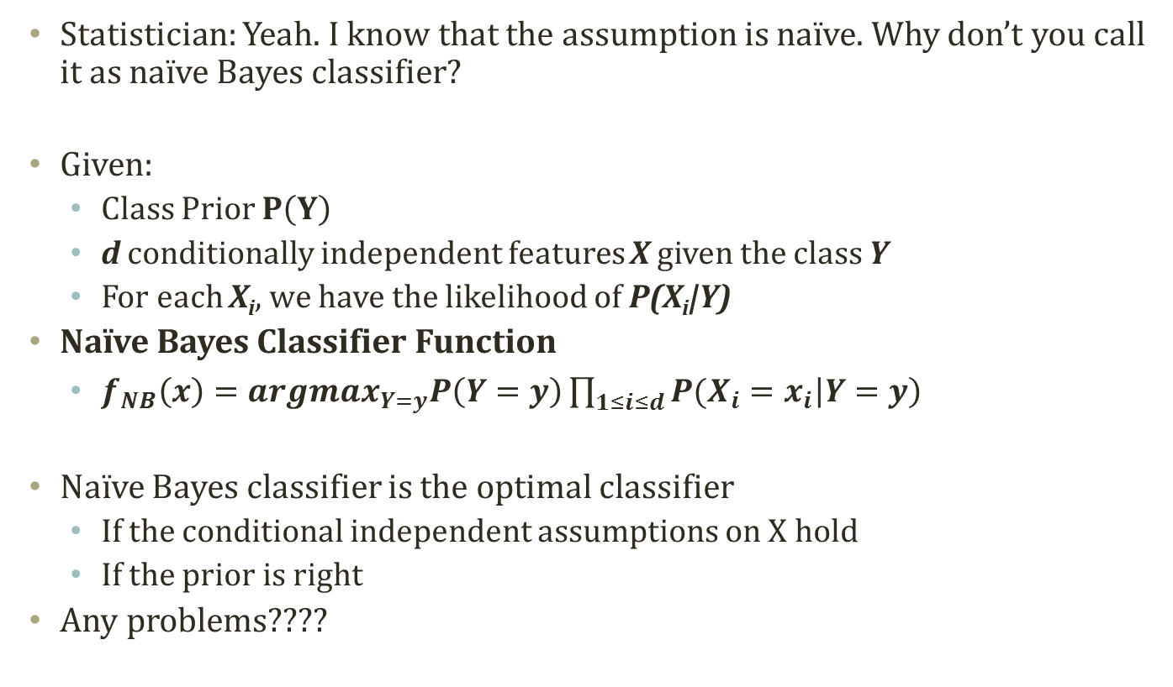
Naïve Bayes Classifier
Statistician: Yeah. I know that the assumption is naïve. Why don’t you call it as naïve Bayes classifier?
Given:
Class Prior $P\left(Y\right)$
d conditionally independent features X given the class Y
For each X_{i}, we have the likelihood of P(X_{i}|Y)
Naïve Bayes Classifier Function
$f_{NB}\left(x\right)={argmax}_{Y=y}P\left(Y=y\right)\prod_{1≤i≤d}{P(X_{i}=x_{i}\left|Y=y\right)}$
Naïve Bayes classifier is the optimal classifier
If the conditional independent assumptions on X hold
If the prior is right
Any problems????

Slide 18
Problem of Naïve Bayes Classifier
Problem 1: Naïve assumption
Many, many, many cases, the variables of X are correlated
Why?
Multi-collinearity
Problem 2: Incorrect Probability Estimations
Billionaire
Head, Head, Head…
MLE with insufficient data
There is no chance of Tail!
P(Y=tail) = 0
MAP with stupid prior
Is either our dataset or knowledge good enough to estimate the prior?
Problem 2 is always there!
Problem 1 is introduced by our assumption!

Slide 19
Text mining application: simple sentiment classification

Slide 20

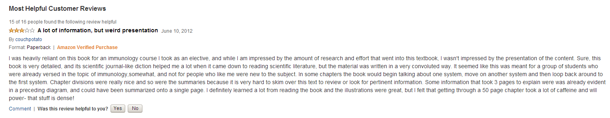
Product Review and Sentiment Analysis
Amazon
Product information
Also, product review
Product review
Some are positive
Some are negative
What-if we have 10,000 reviews and want to find the negative ones?

Slide 21


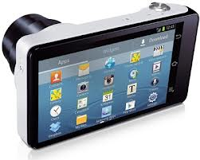

Why simple word searching doesn’t work
There are universal good and bad words
Excellent, good, super…
Horrible, worst, never…
How about this?
Cool?
Cool Beer
Hot?
Hot Pizza
Big?
Big LCD
Small?
Small Size
Searching and counting → Probabilistic approach

Slide 22
Bag Of Words
For statistical analyses
We turned the review text into a vector
A vector <1,0,0,1>
A word list <I, cool, lcd, reliant>
Together,
The review contains words: “I” and “reliant”

Slide 23
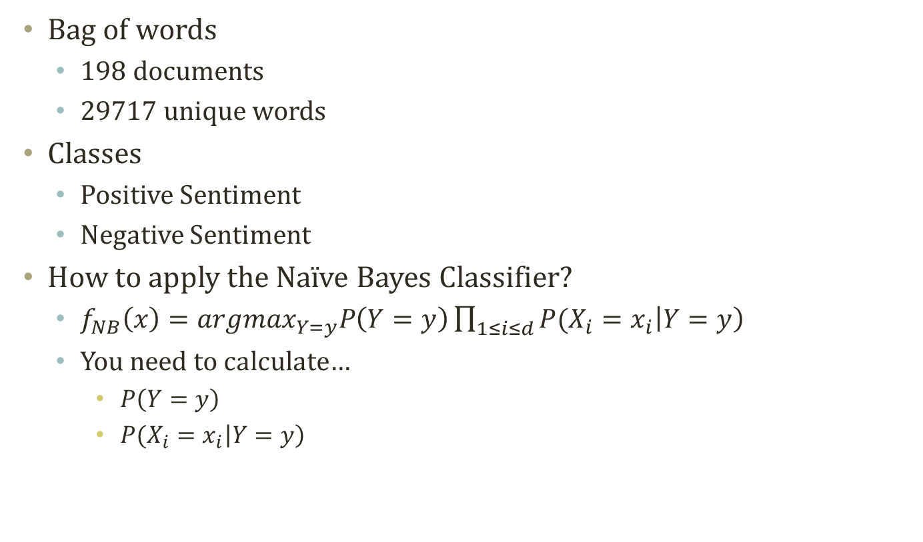
Sample Dataset
Bag of words
198 documents
29717 unique words
Classes
Positive Sentiment
Negative Sentiment
How to apply the Naïve Bayes Classifier?
$f_{NB}\left(x\right)={argmax}_{Y=y}P\left(Y=y\right)\prod_{1≤i≤d}{P(X_{i}=x_{i}\left|Y=y\right)}$
You need to calculate…
$P\left(Y=y\right)$
$P(X_{i}=x_{i}\left|Y=y\right)$

Slide 24
Matlab Exercise!
Let’s do some coding…

Slide 25
Acknowledgement
This slideset is greatly influenced
By Prof. Eric P. Xing at CMU

Slide 26
Further Readings
Bishop Chapter 1, 8.2

